Slide 1
Photocurrent in a P-N junction diode

Slide 2
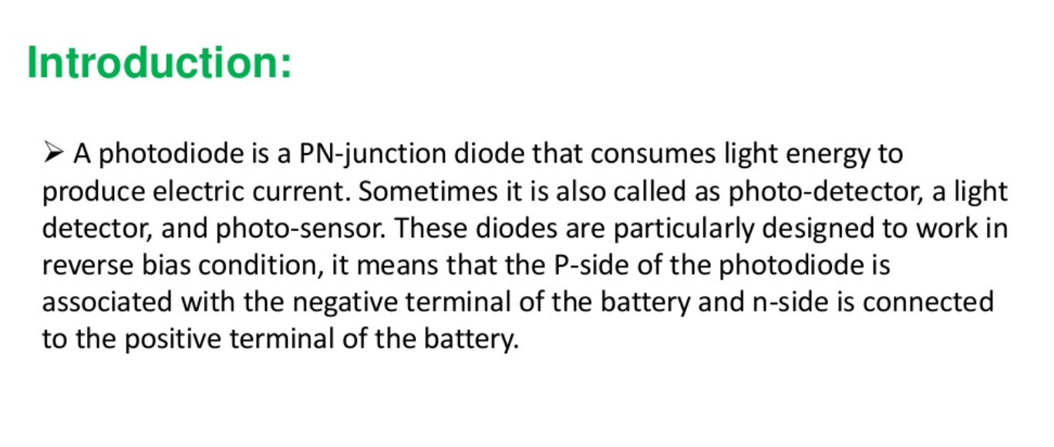

Slide 3
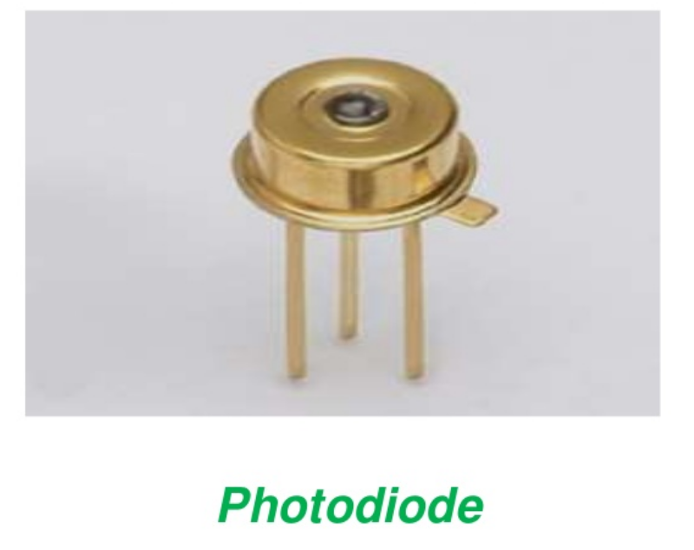

Slide 4
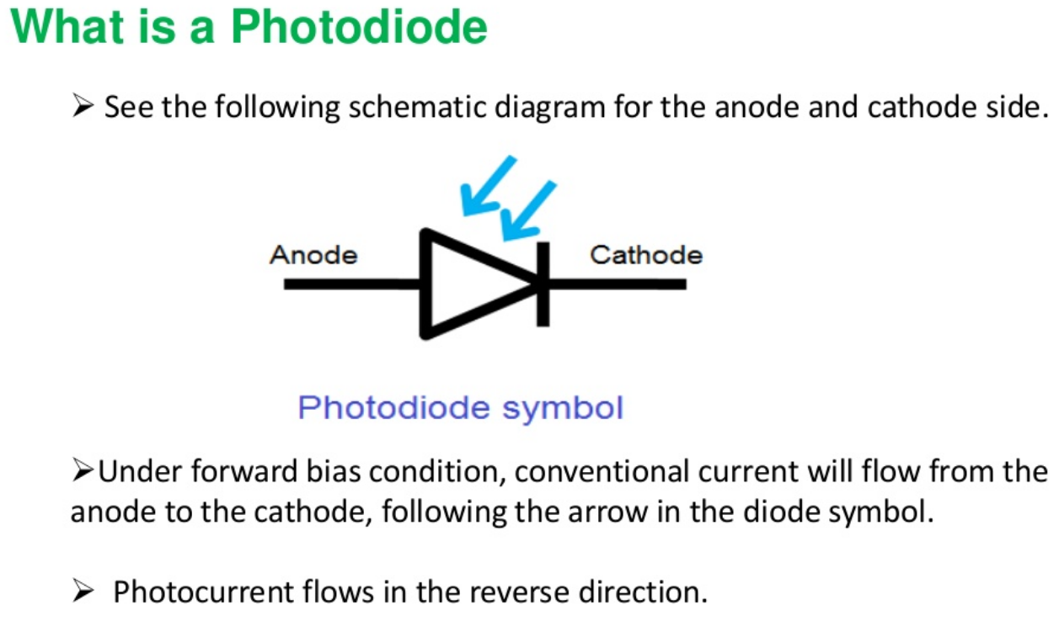

Slide 5
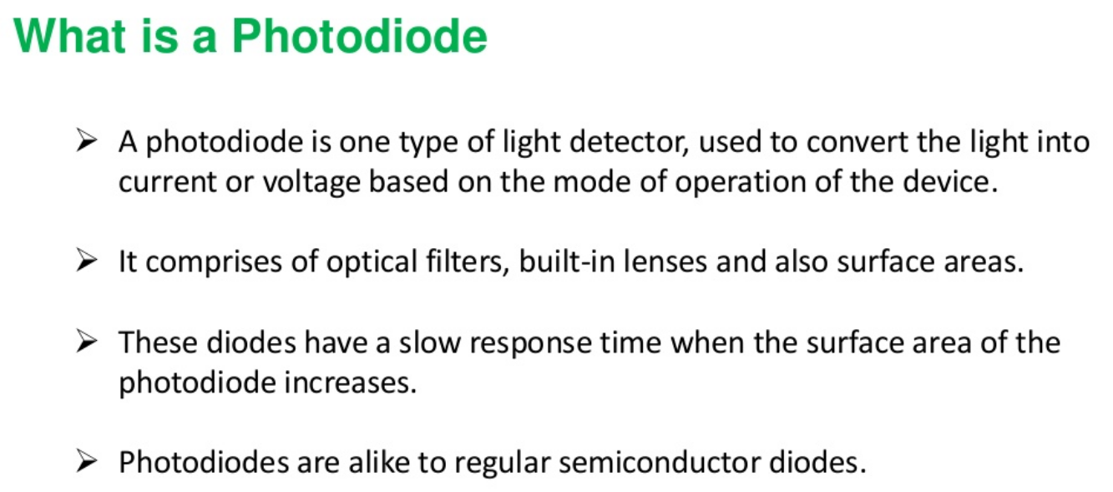

Slide 6
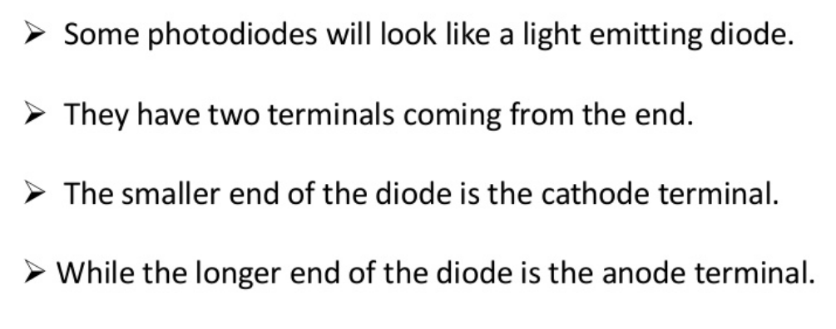

Slide 7
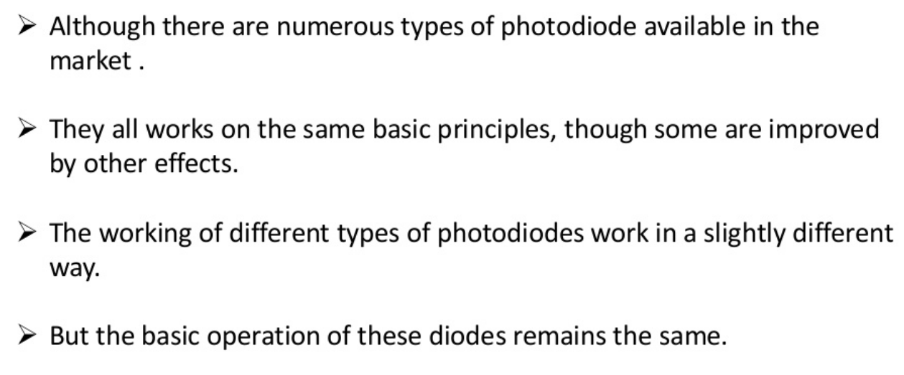

Slide 8
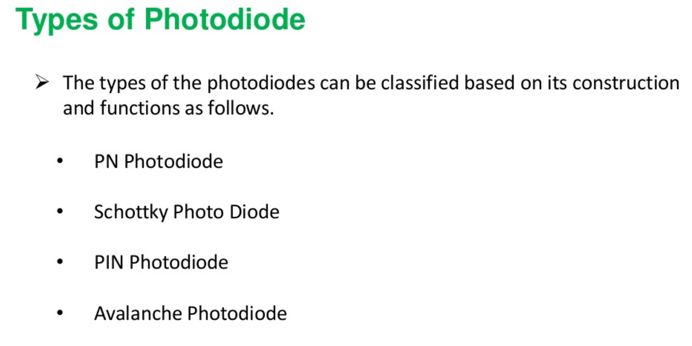

Slide 9
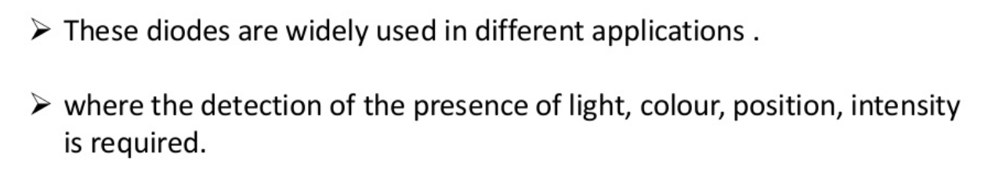
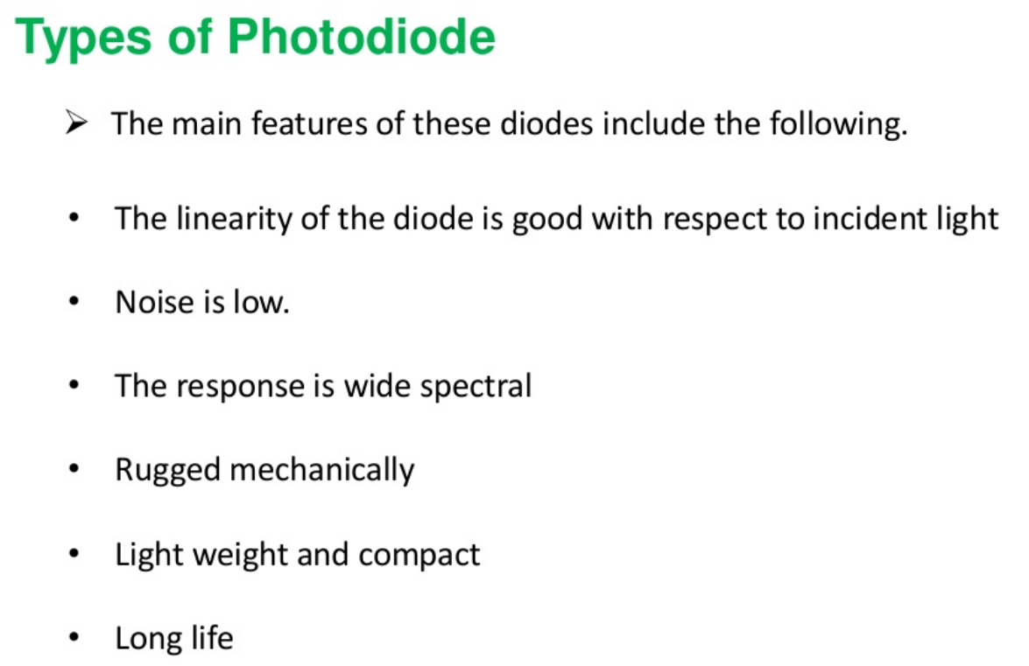

Slide 10
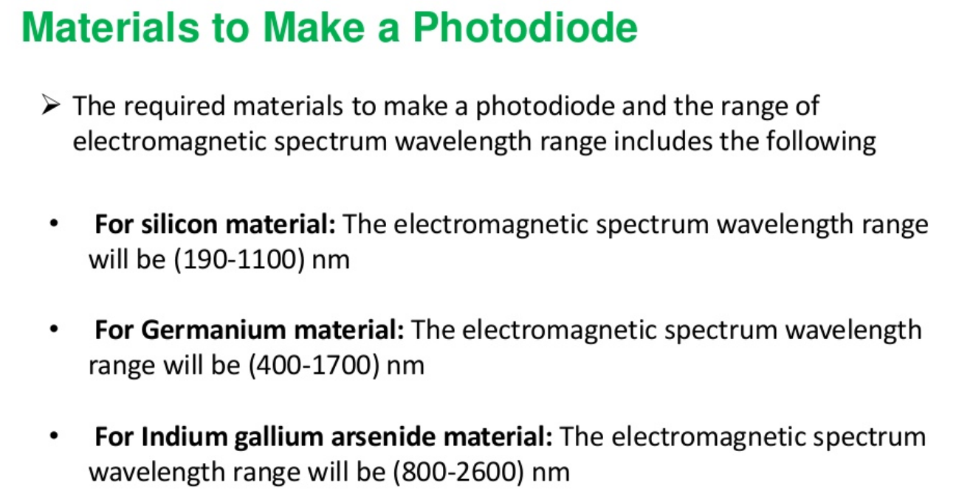
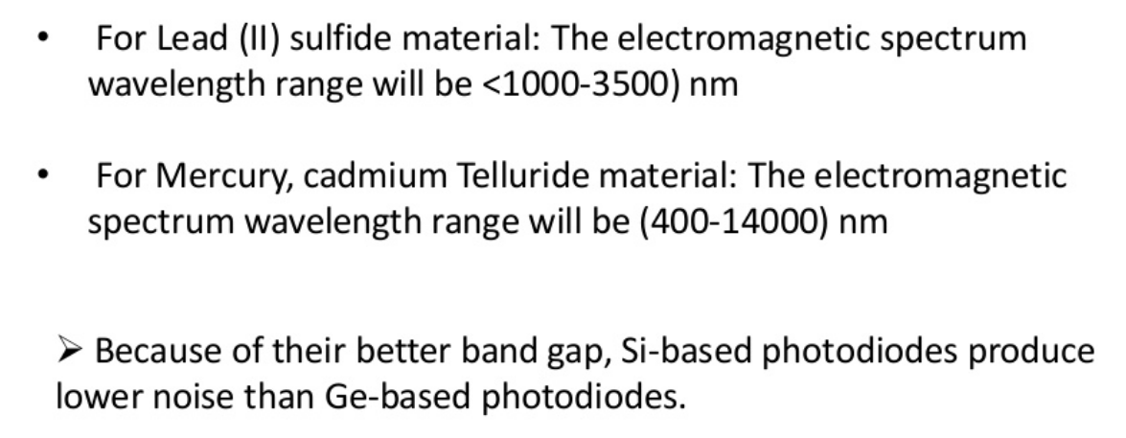

Slide 11
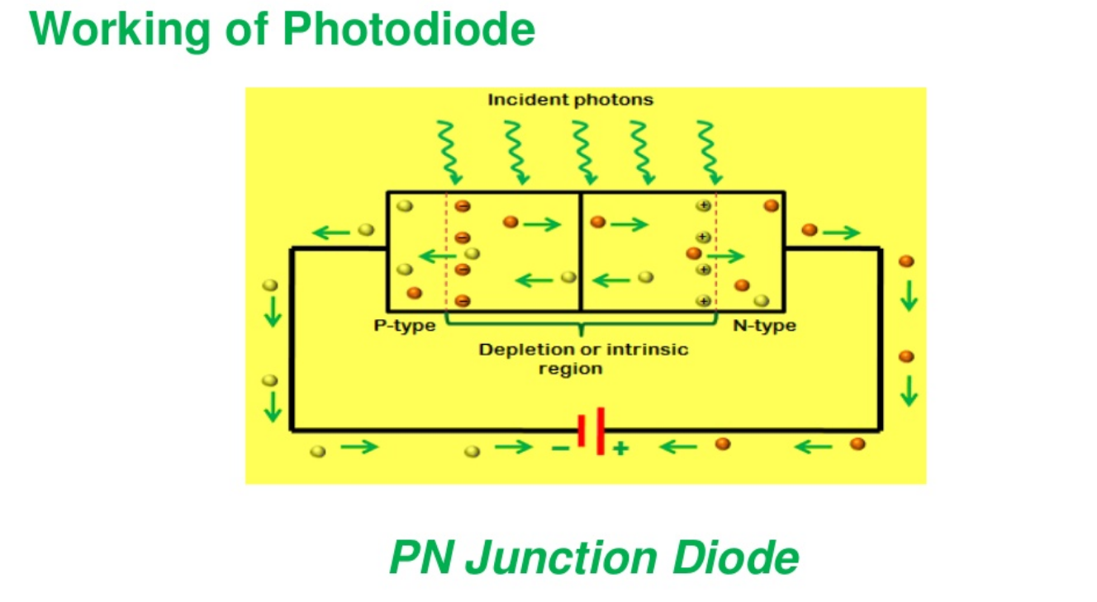

Slide 12
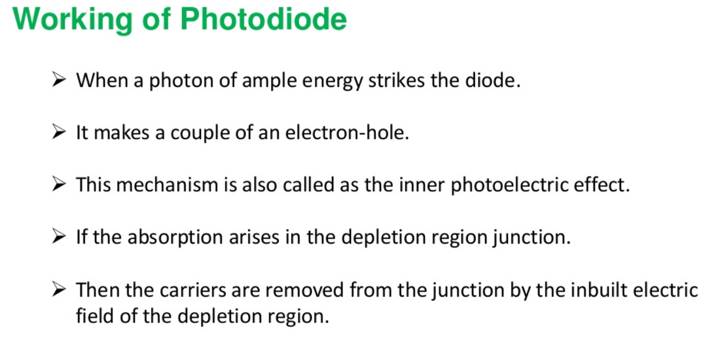
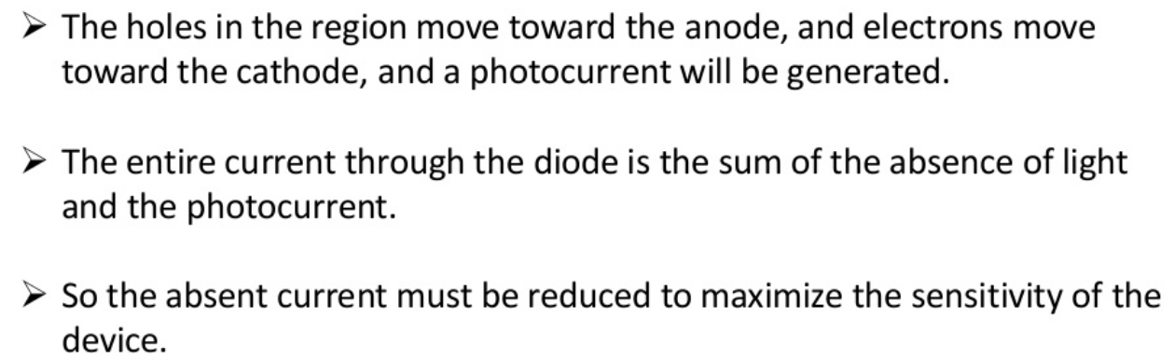

Slide 13
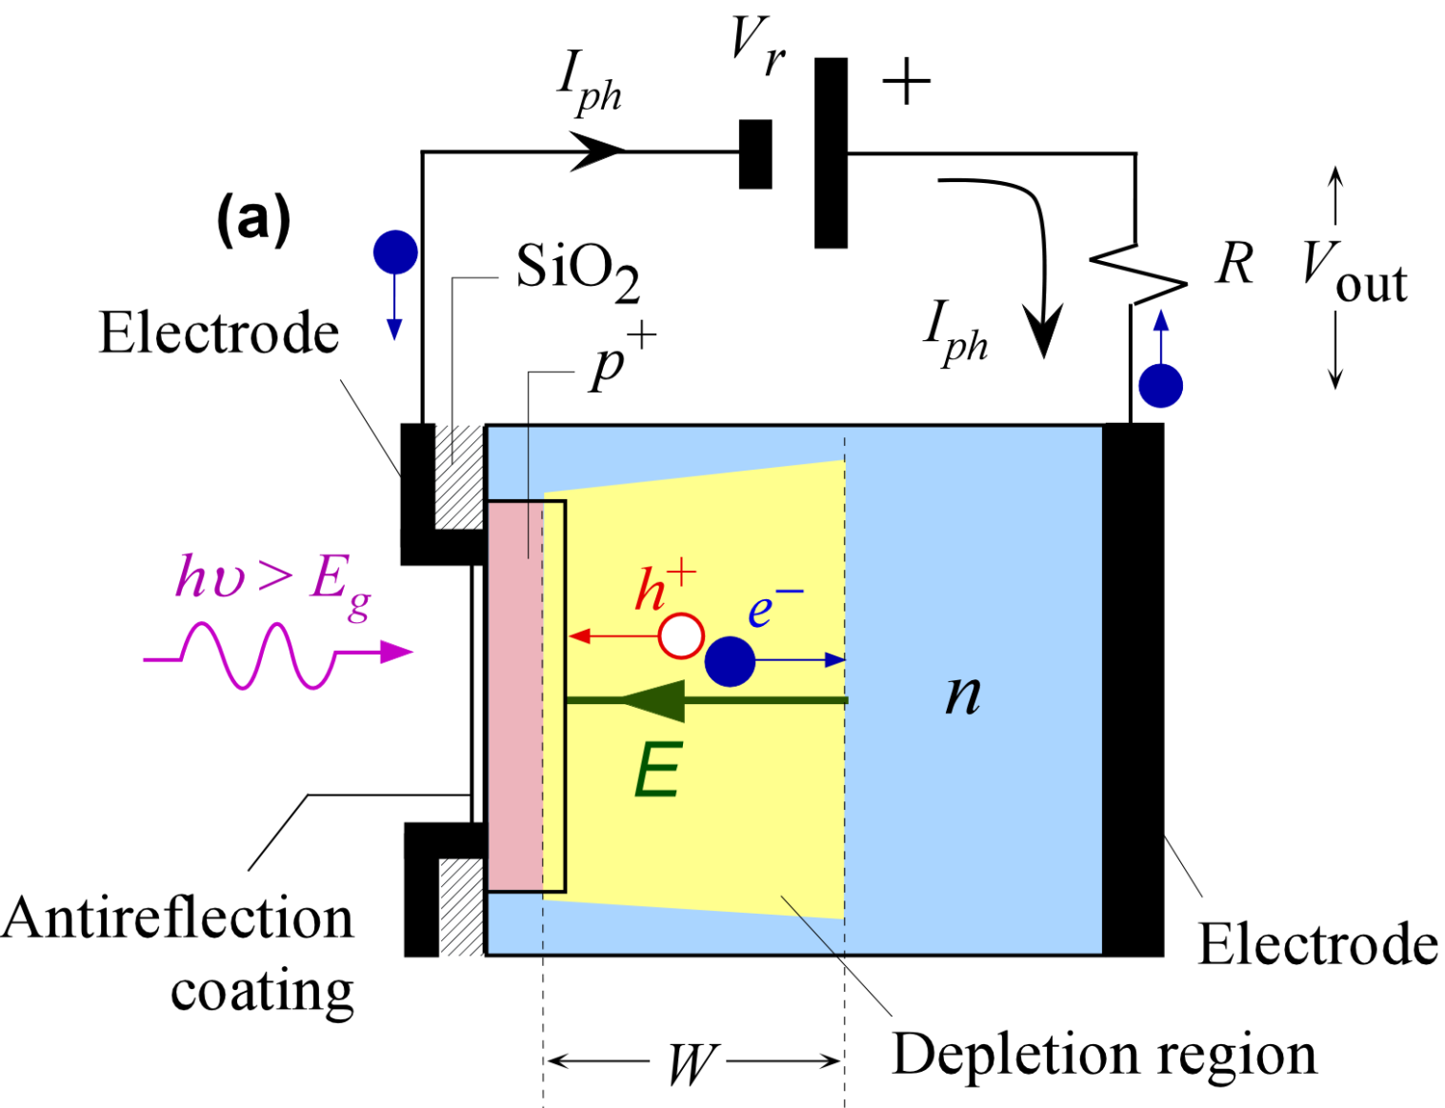
pn Junction Photodiode
A schematic diagram of a reverse biased pn junction photodiode.

Slide 14
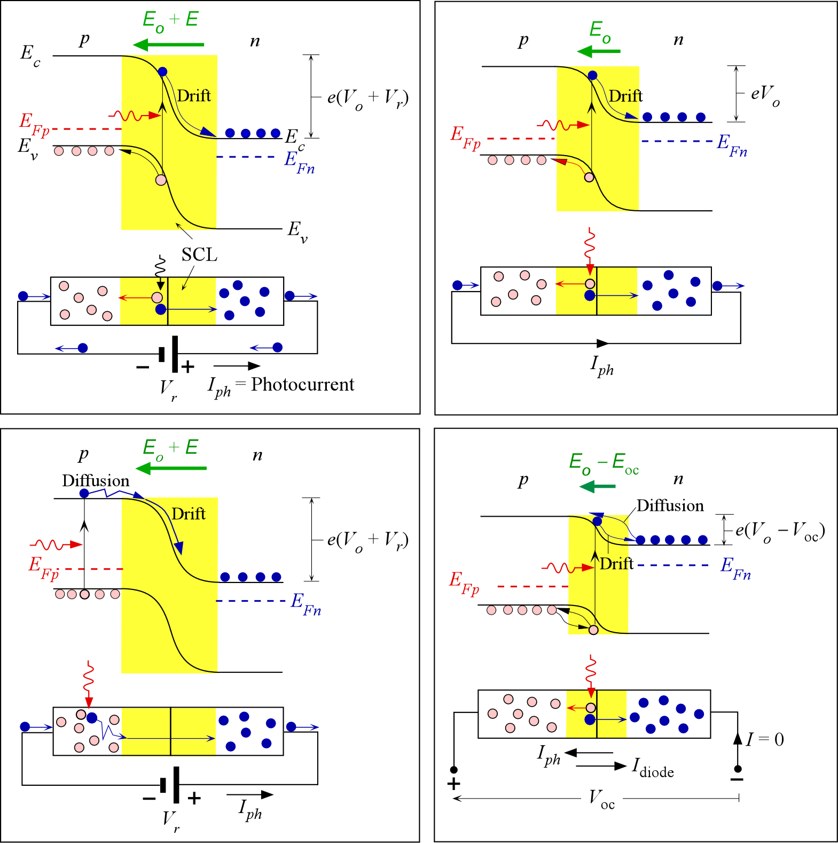
pn Junction Photodiode
A reverse biased pn junction. Photogeneration inside the SCL generates an electron and a hole. Both fall their respective energy hills (electron along E_{c} and hole along E_{v}) i.e. they drift, and cause a photocurrent I_{ph} in the external circuit.

Slide 15
pn Junction Photodiode
Photogeneration occurs in the neutral region. The electron has to diffuse to the depletion layer and then roll down the energy hill i.e. drift across the SCL.

Slide 16
pn Junction Photodiode
A shorted pn junction. The photogenerated electron and hole in the SCL roll down their energy hills, i.e. drift across the SCL, and cause a current I_{ph} in the external circuit.

Slide 17
pn Junction Photodiode
The pn junction in open circuit. The photogenerated electron and hole roll down their energy hills (drift) but there is a voltage V_{oc} across the diode that causes them the diffuse back so that the net current is zero.

Slide 18

APPLICATIONS:

The various applications of photodiodes are

Compact disc players

Smoke detectors

Space applications

Photodiodes are used in medical applications such as computedtomography, instruments to analyse samples, and pulse oximeters.

Photodiodes are used for optical communications.

Photodiodes are used to measure extremely low light intensities.
APPLICATIONS
The various applications of photodiodes are
Compact disc players
Smoke detectors
Space applications
Photodiodes are used in medical applications such as computedtomography, instruments to analyse samples, and pulse oximeters.
Photodiodes are used for optical communications.
Photodiodes are used to measure extremely low light intensities.

